Slide 1

APEX INSTITUTE OF TECHNOLOGY
DEPARTMENT OF COMPUTER SCIENCE & ENGINEERING
Statistics for Data Science(23CSH-233)
Faculty: Prof. (Dr.) Madan Lal Saini(E13485)
Lecture – 22-23
Normal Distribution
DISCOVER . LEARN . EMPOWER

Slide 2
Statistics for Data Science : Course Objectives
COURSE OBJECTIVES
The Course aims to:
To equip students with the skills to summarize and interpret data using descriptive statistics and visualization techniques.
To develop a foundational understanding of probability and its applications in data science.
To enable students to perform hypothesis testing and construct confidence intervals for statistical inference.
To teach students how to build and assess linear and logistic regression models for predictive analysis.
To provide hands-on experience with statistical software for data manipulation, analysis, and visualization.

Slide 3
COURSE OUTCOMES
On completion of this course, the students shall be able to:-
CO1 | Summarize and describe the main features of a dataset using measures such as mean, median, mode, variance, and standard deviation, as well as graphical representations like histograms, box plots, and scatter plots.
CO2 | Understand of probability theory, including concepts such as random variables, probability distributions, and the law of large numbers, enabling them to model and reason about uncertainty in data.
CO3 | Apply/perform statistical inference, including hypothesis testing, confidence interval estimation, and p-value computation, to draw valid conclusions from sample data about larger populations.
CO4 | Apply linear and logistic regression techniques to identify relationships between variables, make predictions, and evaluate model performance.
CO5 | Utilize statistical software tools to perform data analysis, including data cleaning, transformation, visualization, and implementing various statistical methods.

Slide 4
Unit-2 Syllabus
Unit-2 | Probability Distribution
Probability Distribution | Concept of Random Variable, Bernoulli Distribution, Binomial Distribution, Poisson Distribution, Normal Distribution.
Correlation and Regression | Concept and types, Karl Pearson Method, Rank, Spearman Method, Least Square Method, Regression line by regression coefficient

Slide 5
SUGGESTIVE READINGS
TEXT BOOKS:
T1. Hastie, Trevor, et al., The elements of statistical learning. Vol. 2. No. 1. New York: Publisher: Springer, Edition: Second Edition (2009), ISBN: 978-0387848570
T2. Montgomery, Douglas C., and George C. Runger. Applied statistics and probability for engineers. John Wiley & Sons, 2010.
T3. Probability and Statistics The Science of Uncertainty Second Ed., Michael J. Evans and Jeffrey S. Rosenthal.
REFERENCE BOOKS:
R1. Practical Statistics for Data Scientists: 50 Essential Concepts, Authors: Peter Bruce, et al, Publisher: O'Reilly Media, Edition: Second Edition (2020), ISBN: 978-1492072942
R2. An Introduction to Statistical Learning: with Applications in R, Authors: Gareth James, et al, Publisher: Springer, Edition: Second Edition (2021), ISBN: 978-1071614174
R3. Think Stats: Exploratory Data Analysis in Python, Author: Allen B. Downey, Publisher: O'Reilly Media, Publication Year: 2014 (2nd Edition), ISBN: 978-1491907337

Slide 6
Examples of continuous probability distributions:
The normal and standard normal

Slide 7
The Normal Distribution
f(X)
Changing μ shifts the distribution left or right.
Changing σ increases or decreases the spread.
σ
μ
X

Slide 8
The Normal Distribution: as mathematical function (pdf)
This is a bell shaped curve with different centers and spreads depending on μ and σ
Note constants:
π=3.14159
e=2.71828

Slide 9
The Normal PDF
It’s a probability function, so no matter what the values of μ and σ, must integrate to 1!

Slide 10
Normal distribution is defined by its mean and standard dev.
E(X)=μ =
Var(X)=σ² =
Standard Deviation(X)=σ

Slide 11
**The beauty of the normal curve:
No matter what μ and σ are, the area between μ-σ and μ+σ is about 68%; the area between μ-2σ and μ+2σ is about 95%; and the area between μ-3σ and μ+3σ is about 99.7%. Almost all values fall within 3 standard deviations.

Slide 12
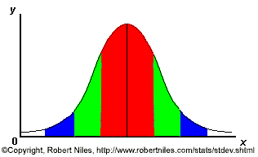
68-95-99.7 Rule
68% of the data
95% of the data
99.7% of the data
Notes:
SAY: within 1 standard deviation either way of the mean
within 2 standard deviations of the mean
within 3 standard deviations either way of the mean
WORKS FOR ALL NORMAL CURVES NO MATTER HOW SKINNY OR FAT

Slide 13
68-95-99.7 Rule in Math terms…

Slide 14
How good is rule for real data?
Check some example data:
The mean of the weight of the women = 127.8
The standard deviation (SD) = 15.5

Slide 15
68% of 120 = .68x120 = ~ 82 runners
In fact, 79 runners fall within 1-SD (15.5 lbs) of the mean.
112.3
127.8
143.3

Slide 16
95% of 120 = .95 x 120 = ~ 114 runners
In fact, 115 runners fall within 2-SD’s of the mean.
96.8
127.8
158.8

Slide 17
99.7% of 120 = .997 x 120 = 119.6 runners
In fact, all 120 runners fall within 3-SD’s of the mean.
81.3
127.8
174.3

Slide 18
Example
Suppose SAT scores roughly follows a normal distribution in the U.S. population of college-bound students (with range restricted to 200-800), and the average math SAT is 500 with a standard deviation of 50, then:
68% of students will have scores between 450 and 550
95% will be between 400 and 600
99.7% will be between 350 and 650

Slide 19
Example
BUT…
What if you wanted to know the math SAT score corresponding to the 90th percentile (=90% of students are lower)?
P(X≤Q) = .90 →
Solve for Q?….Yikes!

Slide 20
The Standard Normal (Z): “Universal Currency”
The formula for the standardized normal probability density function is

Slide 21
The Standard Normal Distribution (Z)
All normal distributions can be converted into the standard normal curve by subtracting the mean and dividing by the standard deviation:
Somebody calculated all the integrals for the standard normal and put them in a table! So we never have to integrate!
Even better, computers now do all the integration.

Slide 22
Comparing X and Z units
100
200
X
(μ = 100, σ = 50)
0
2.0
Z
(μ = 0, σ = 1)

Slide 23
Example
For example: What’s the probability of getting a math SAT score of 575 or less, μ=500 and σ=50?
i.e., A score of 575 is 1.5 standard deviations above the mean
Yikes!
But to look up Z= 1.5 in standard normal chart (or enter into SAS)→ no problem! = .9332

Slide 24
Practice problem
If birth weights in a population are normally distributed with a mean of 109 oz and a standard deviation of 13 oz,
What is the chance of obtaining a birth weight of 141 oz or heavier when sampling birth records at random?
What is the chance of obtaining a birth weight of 120 or lighter?

Slide 25
Answer
What is the chance of obtaining a birth weight of 141 oz or heavier when sampling birth records at random?
From the chart or SAS → Z of 2.46 corresponds to a right tail (greater than) area of: P(Z≥2.46) = 1-(.9931)= .0069 or .69 %

Slide 26
Answer
b. What is the chance of obtaining a birth weight of 120 or lighter?
From the chart or SAS → Z of .85 corresponds to a left tail area of:
P(Z≤.85) = .8023= 80.23%

Slide 27
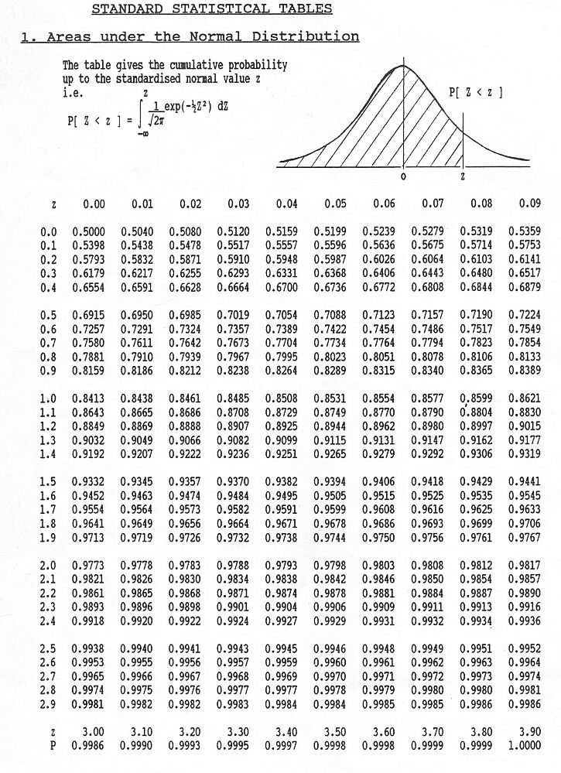
Looking up probabilities in the standard normal table
What is the area to the left of Z=1.51 in a standard normal curve?
Area is 93.45%
Z=1.51
Z=1.51

Slide 28
Normal probabilities in SAS
data _null_;
theArea=probnorm(1.5);
put theArea;
run;
0.9331927987
And if you wanted to go the other direction (i.e., from the area to the Z score (called the so-called “Probit” function→
data _null_;
theZValue=probit(.93);
put theZValue;
run;
1.4757910282
The “probnorm(Z)” function gives you the probability from negative infinity to Z (here 1.5) in a standard normal curve.
The “probit(p)” function gives you the Z-value that corresponds to a left-tail area of p (here .93) from a standard normal curve. The probit function is also known as the inverse standard normal function.

Slide 29
Probit function: the inverse
φ(area)= Z: gives the Z-value that goes with the probability you want
For example, recall SAT math scores example. What’s the score that corresponds to the 90th percentile?
In Table, find the Z-value that corresponds to area of .90 → Z= 1.28
Or use SAS
data _null_;
theZValue=probit(.90);
put theZValue;
run;
1.2815515655
If Z=1.28, convert back to raw SAT score →
1.28 =
X – 500 =1.28 (50)
X=1.28(50) + 500 = 564 (1.28 standard deviations above the mean!)
`

Slide 30
Are my data “normal”?
Not all continuous random variables are normally distributed!!
It is important to evaluate how well the data are approximated by a normal distribution

Slide 31
Are my data normally distributed?
Look at the histogram! Does it appear bell shaped?
Compute descriptive summary measures—are mean, median, and mode similar?
Do 2/3 of observations lie within 1 std dev of the mean? Do 95% of observations lie within 2 std dev of the mean?
Look at a normal probability plot—is it approximately linear?
Run tests of normality (such as Kolmogorov-Smirnov). But, be cautious, highly influenced by sample size!

Slide 32
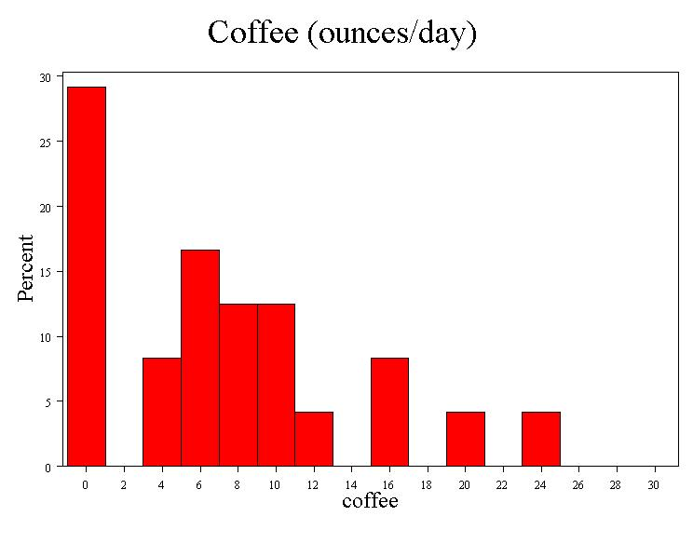
Data from our class…
Median = 6
Mean = 7.1
Mode = 0
SD = 6.8
Range = 0 to 24
(= 3.5 σ)

Slide 33
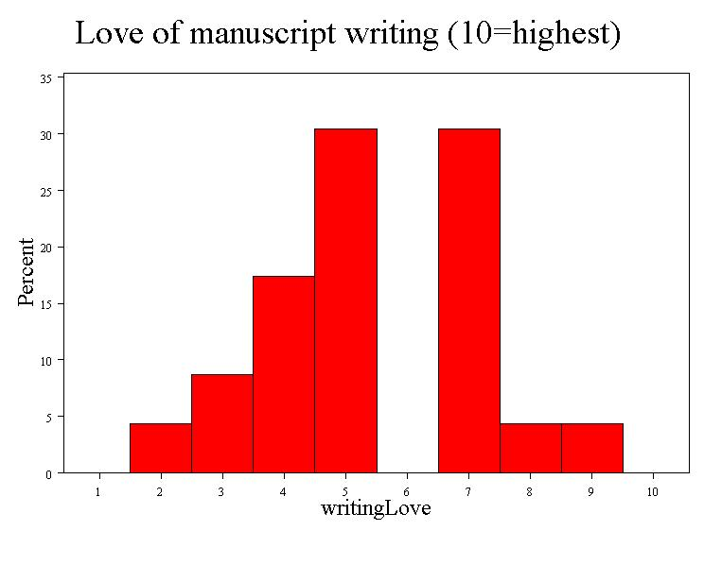
Data from our class…
Median = 5
Mean = 5.4
Mode = none
SD = 1.8
Range = 2 to 9
(~ 4 σ)

Slide 34
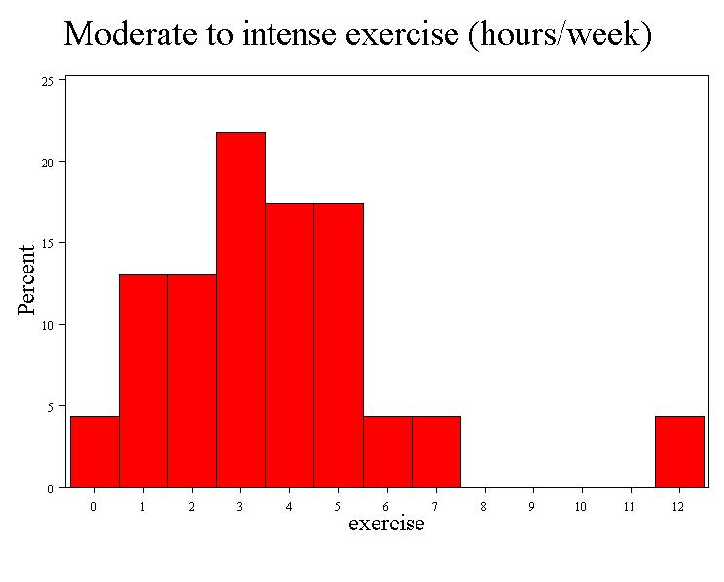
Data from our class…
Median = 3
Mean = 3.4
Mode = 3
SD = 2.5
Range = 0 to 12
(~ 5 σ)

Slide 35
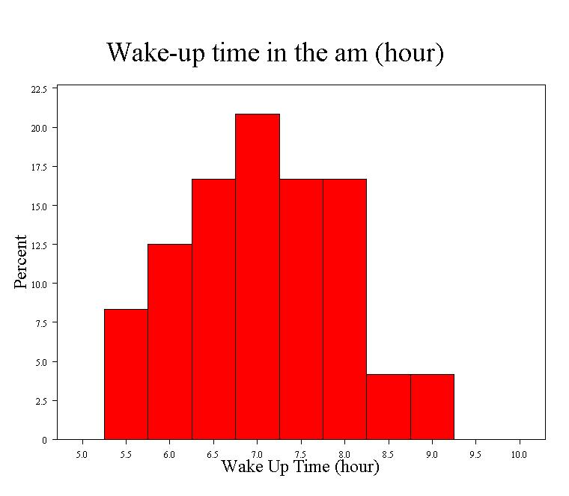
Data from our class…
Median = 7:00
Mean = 7:04
Mode = 7:00
SD = :55
Range = 5:30 to 9:00
(~4 σ)

Slide 36
Data from our class…
7.1 +/- 6.8 =
0.3 – 13.9
0.3
13.9

Slide 37
Data from our class…
7.1 +/- 2*6.8 =
0 – 20.7

Slide 38
Data from our class…
7.1 +/- 3*6.8 =
0 – 27.5

Slide 39
Data from our class…
5.4 +/- 1.8 =
3.6 – 7.2
3.6
7.2

Slide 40
Data from our class…
5.4 +/- 2*1.8 =
1.8 – 9.0
1.8
9.0

Slide 41
Data from our class…
5.4 +/- 3*1.8 =
0– 10
0
10

Slide 42
Data from our class…
0.9
5.9
3.4 +/- 2.5=
0.9 – 7.9

Slide 43
Data from our class…
0
8.4
3.4 +/- 2*2.5=
0 – 8.4

Slide 44
Data from our class…
0
10.9
3.4 +/- 3*2.5=
0 – 10.9

Slide 45
Data from our class…
6:09
7:59
7:04+/- 0:55 =
6:09 – 7:59

Slide 46
Data from our class…
5:14
8:54
7:04+/- 2*0:55 =
5:14 – 8:54

Slide 47
Data from our class…
4:19
9:49
7:04+/- 2*0:55 =
4:19 – 9:49

Slide 48
The Normal Probability Plot
Normal probability plot
Order the data.
Find corresponding standardized normal quantile values:
Plot the observed data values against normal quantile values.
Evaluate the plot for evidence of linearity.

Slide 49
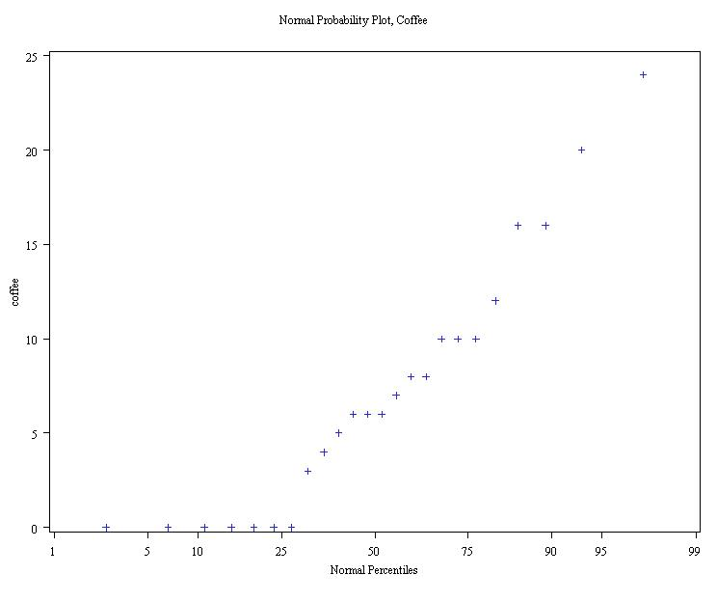
Normal probability plot coffee…
Right-Skewed!
(concave up)

Slide 50
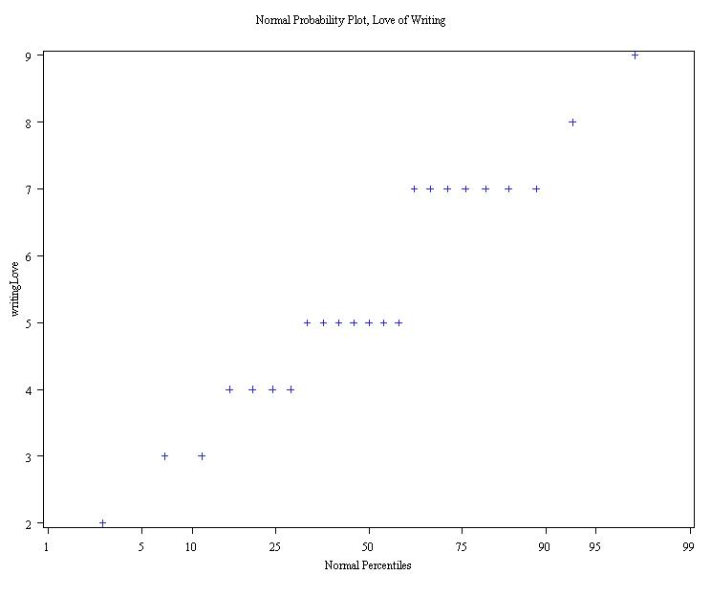
Normal probability plot love of writing…
Neither right-skewed or left-skewed, but big gap at 6.

Slide 51
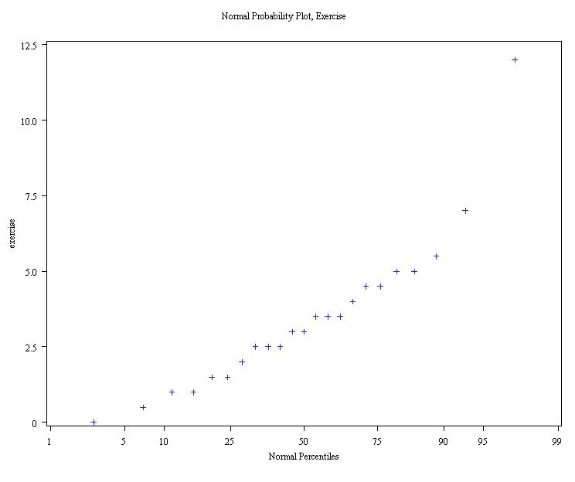
Norm prob. plot Exercise…
Right-Skewed!
(concave up)

Slide 52
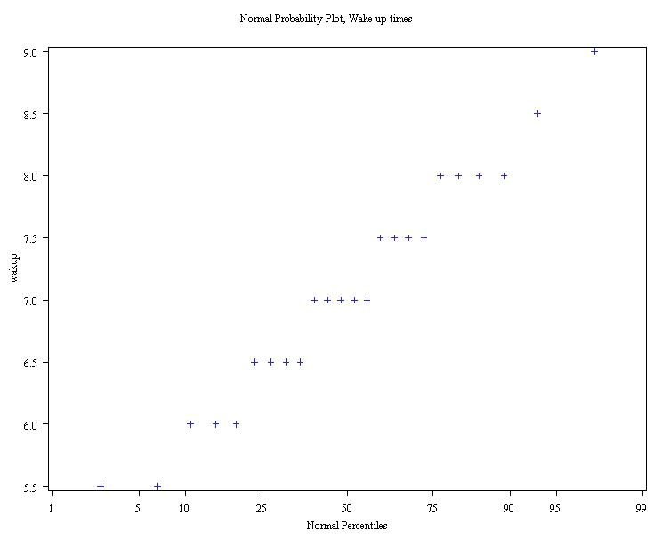
Norm prob. plot Wake up time
Closest to a straight line…

Slide 53
Formal tests for normality
Results:
Coffee: Strong evidence of non-normality (p<.01)
Writing love: Moderate evidence of non-normality (p=.01)
Exercise: Weak to no evidence of non-normality (p>.10)
Wakeup time: No evidence of non-normality (p>.25)

Slide 54
Normal approximation to the binomial
When you have a binomial distribution where n is large and p is middle-of-the road (not too small, not too big, closer to .5), then the binomial starts to look like a normal distribution→ in fact, this doesn’t even take a particularly large n→
Recall: What is the probability of being a smoker among a group of cases with lung cancer is .6, what’s the probability that in a group of 8 cases you have less than 2 smokers?

Slide 55
Normal approximation to the binomial
When you have a binomial distribution where n is large and p isn’t too small (rule of thumb: mean>5), then the binomial starts to look like a normal distribution→
Recall: smoking example…
.27
Starting to have a normal shape even with fairly small n. You can imagine that if n got larger, the bars would get thinner and thinner and this would look more and more like a continuous function, with a bell curve shape. Here np=4.8.
0
1
2
3
4
5
6
7
8

Slide 56
Normal approximation to binomial
.27
0
1
2
3
4
5
6
7
8
What is the probability of fewer than 2 smokers?
Exact binomial probability (from before) = .00065 + .008 = .00865
Normal approximation probability:
μ=4.8
σ=1.39
P(Z<2)=.022

Slide 57
A little off, but in the right ballpark… we could also use the value to the left of 1.5 (as we really wanted to know less than but not including 2; called the “continuity correction”)…
A fairly good approximation of the exact probability, .00865.
P(Z≤-2.37) =.0069

Slide 58
Practice problem
1. You are performing a cohort study. If the probability of developing disease in the exposed group is .25 for the study duration, then if you sample (randomly) 500 exposed people, What’s the probability that at most 120 people develop the disease?

Slide 59
Answer
By hand (yikes!):
P(X≤120) = P(X=0) + P(X=1) + P(X=2) + P(X=3) + P(X=4)+….+ P(X=120)=
+
+
+
…
OR Use SAS:
data _null_;
Cohort=cdf('binomial', 120, .25, 500);
put Cohort;
run;
0.323504227
OR use, normal approximation:
μ=np=500(.25)=125 and σ²=np(1-p)=93.75; σ=9.68
P(Z<-.52)= .3015

Slide 60
Proportions…
The binomial distribution forms the basis of statistics for proportions.
A proportion is just a binomial count divided by n.
For example, if we sample 200 cases and find 60 smokers, X=60 but the observed proportion=.30.
Statistics for proportions are similar to binomial counts, but differ by a factor of n.

Slide 61
Stats for proportions
For binomial:
Differs by a factor of n.
Differs by a factor of n.
For proportion:
P-hat stands for “sample proportion.”

Slide 62
It all comes back to Z…
Statistics for proportions are based on a normal distribution, because the binomial can be approximated as normal if np>5

Slide 63
References
Books:
Hastie, Trevor, et al., The elements of statistical learning. Vol. 2. No. 1. New York: Publisher: Springer, Edition: Second Edition (2009), ISBN: 978-0387848570
Practical Statistics for Data Scientists: 50 Essential Concepts, Authors: Peter Bruce, et al, Publisher: O'Reilly Media, Edition: Second Edition (2020), ISBN: 978-1492072942
Research Papers:
Carmichael, Iain, and J. S. Marron. "Data science vs. statistics: two cultures?." Japanese Journal of Statistics and Data Science 1.1 (2018): 117-138.
Hardin, Johanna, et al. "Data science in statistics curricula: Preparing students to “think with data”." The American Statistician 69.4 (2015): 343-353.
Websites:
https://365datascience.com/resources-center/course-notes/statistics/
https://www.geeksforgeeks.org/7-basic-statistics-concepts-for-data-science/
Videos:
https://www.youtube.com/playlist?list=PLZ2ps__7DhBYrMs3zybOqr1DzMFCX49xG

Slide 64
THANK YOU
For queries
Email: madan.e13485@cumail.in

